Slide 1
Help PowerCo:
Identify drivers of increasing SME customer defections
Devise and implement a strategy to counter the churn issue

Slide 2
it is possible to predict the customers which are most likely to churn
a hypothesis that clients are switching to cheaper providers so the first action to be tried will be to offer customers with high propensity of churning a 20% discount
What are the most explicative variables for churn?
Is there a correlation between subscribed power and consumption?
Is there a link between channel sales and churn?

Slide 3
Dataset
XXX of SME customers in January 2016
Label on whether or not they have churned by March 2016
features of SME customers in January 2016
the prices from 2015 for these customers

Slide 4
Steps
Descriptive
Model training
Model score
Comparing models
Score customers in descending order of the propensity to churn
Predict “churn” vs. “no-churn”
Next steps

Slide 5
Appendix
Field name | Description
id | contact id
activity_new | category of the company's activity
campaign_disc_ele | code of the electricity campaign the customer last subscribed to
channel_sales | code of the sales channel
cons_12m | electricity consumption of the past 12 months
cons_gas_12m | gas consumption of the past 12 months
cons_last_month | electricity consumption of the last month
date_activ | date of activation of the contract
date_end | registered date of the end of the contract
date_first_activ | date of first contract of the client
date_modif_prod | date of last modification of the product
date_renewal | date of the next contract renewal
forecast_base_bill_ele | forecasted electricity bill baseline for next month
forecast_base_bill_year | forecasted electricity bill baseline for calendar year
forecast_bill_12m | forecasted electricity bill baseline for 12 months
forecast_cons | forecasted electricity consumption for next month
forecast_cons_12m | forecasted electricity consumption for next 12 months
forecast_cons_year | forecasted electricity consumption for next calendar year
forecast_discount_energy | forecasted value of current discount
forecast_meter_rent_12m | forecasted bill of meter rental for the next 12 months
forecast_price_energy_p1 | forecasted energy price for 1st period
forecast_price_energy_p2 | forecasted energy price for 2nd period
forecast_price_pow_p1 | forecasted power price for 1st period

Slide 6
Field name | Description
has_gas | indicated if client is also a gas client
imp_cons | current paid consumption
margin_gross_pow_ele | gross margin on power subscription
margin_net_pow_ele | net margin on power subscription
nb_prod_act | number of active products and services
net_margin | total net margin
num_years_antig | antiquity of the client (in number of years)
origin_up | code of the electricity campaign the customer first subscribed to
pow_max | subscribed power
price_date | reference date
price_p1_var | price of energy for the 1st period
price_p2_var | price of energy for the 2nd period
price_p3_var | price of energy for the 3rd period
price_p1_fix | price of power for the 1st period
price_p2_fix | price of power for the 2nd period
price_p3_fix | price of power for the 3rd period
churned | has the client churned over the next 3 months

Slide 7
Metric’s Used for Model Validations (Binary Response)
Receiver Operating Curve – Measures amount of misclassification rate using area under the curve
Cumulative Gains Lift Chart – Measures percent of observed cases in a given category based on model prediction compared to random (no model)

Slide 8
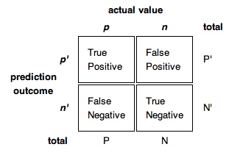
Receiver Operating Curve
If our goal is to only minimize the number of false negatives, i.e. to detect “the true events”, then we want to look at ‘Sensitivity’ and select the model with the highest one
If our goal is to only minimize the number of false positives, then we want to look at ‘Precision’ and choose the model with the highest one
There is a tradeoff between ‘Sensitivity’ and ‘Specificity’ (any increase in ‘Sensitivity’ will be accompanied by a decrease in ‘Specificity’)
Specificity = True Negative Rate = TN / (TN + FP)
Sensitivity = Recall = TP / (TP + FN)
Precision = TP / (TP + FP)

Slide 9
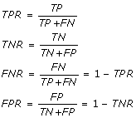
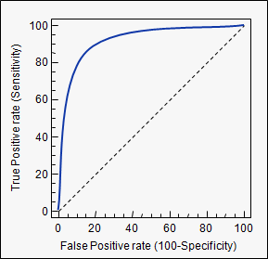
Receiver Operating Curve
ROC Curve (Receiver Operating Characteristic)
A graphical plot that illustrates performance of binary classifier system – Yes/No
Curve is created by plotting the ‘true positive rate’ against the ‘false positive rate’
True-positive rate (‘Sensitivity’) and false-positive rate can be calculated as (1 - Specificity)
AUC (area under the curve) ranges from 0.5 to 1 (higher the better)

Slide 10
Agenda
Statistical modeling vs. machine learning
Decision Trees
Gradient boosted decision trees
Random Forest
Ensemble models
Advantages and disadvantages of machine learning models
Overfitting
Machine learning models by Advanced Analytics
Preliminary Results

Slide 11
Statistical Modeling vs. Machine Learning
Statistical Modeling
Model can be formally expressed in simple mathematical equations (parametric models)
Insight into the process that generated the data (e.g. loss frequency as Poisson process)
Relies on the user to select which explanatory variables should appear in the model, and what degree of smoothing/grouping should take place
Machine Learning
Applies an algorithmic approach instead of a parametric model approach
Focus is on accurate prediction
Model complexity is determined in an automated way

Slide 12
Machine Learning Techniques
Decision Trees
Ensemble Trees
Gradient Boosted Decision Trees
Random Forest
Ensemble Models
Neural Networks
Support Vector Machines
Naïve Bayes
Bayesian Networks

Slide 13
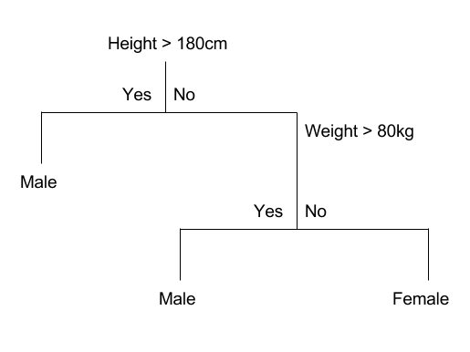
Decision Trees
Example: predict gender using height and weight
Source: http://machinelearningmastery.com
Decision Tree Coding
If Height > 180 cm Then Male
If Height <= 180 cm AND Weight > 80 kg Then Male
If Height <= 180 cm AND Weight <= 80 kg Then Female

Slide 14
Pros/Cons of Decision Trees
Advantages:
Easy to interpret and visualize
Fast and easy to build
Catches interaction effects
Disadvantages:
Prediction accuracy can range from good to poor
Can easily overfit the data
Predicts well on the data it trained on
Predicts poorly on new data

Slide 15
Ensemble Trees
The prediction accuracy of a single decision tree can be improved by combining the predictions of many decision trees i.e. ensemble trees
Why does this work?
Incorporate the diversity of different predictions to create the best of all predictions (wisdom of crowds)
Ensemble Tree Techniques
Gradient Boosted Decision Trees
Random Forest

Slide 16
Gradient Boosted Decision Trees
Long sequence of continuously improving decision trees
The nodes and the split of the next tree tries to correct the imperfections (residuals) of the previous tree
Final prediction is a weighted average or majority vote of all trees
residual₁
residual₂
residual₃
residual₄
Saturation
Tree₁
Tree₂
Tree₃
Tree₄
Tree₅
Tree_{n}
Parameter Tuning
Response variable distribution
Number of trees
Depth of tree
Learn rate
Number of variables per trees

Slide 17
Random Forest
Many independent decision trees (not sequential)
Each tree’s data set is a different variation of the original data set
Variation based on different subsamples of the original variables and observations
Final prediction is an average or majority vote of all trees
Parameter Tuning
Number of trees
Number of variables per tree
Depth of tree
Minimum observations in leaf node
Tree₁
Tree₂
RF
Tree₃
Tree₄
Tree₅
Tree_{n}

Slide 18
Pros/Cons of Ensemble Trees
Advantages:
Higher level of prediction accuracy
Catches interaction effects
Robust at handling correlated variables
Naturally captures non-linear relations
Disadvantages:
Black box modeling, cannot see model estimates
Cannot modify model estimates without accounting for other main effects
Cannot produce factor selects
Parameter tuning can take time to perfect

Slide 19
Ensemble Trees by Advanced Analytics Team
PIP Abuse model
Using policy and accident info at FNOL, predict abusiveness of claimant
Random Forest and Gradient Boosted Tree models captured the highest percentage of truly abusive claimants
% of Abusive Claimants Correctly Identified
 | Cross-Validation |  | Holdout (out-of-time)
 | Train | Test
Random Forest | 52.3% | 51.3% | 49.9%
Gradient Boosted Trees | 55.6% | 55.4% | 49.9%
GLM | 50.2% | 50.2% | 48.9%

Slide 20
Ensemble Models
Combine multiple modeling techniques to make a single, more accurate model.
Meta-modeling (stacking)
Layer 1: fit multiple distinct base models
Layer 2: use 1st layer predictions as input to a 2nd layer model (meta-model), that produces a final prediction
Layer 1
Layer 2
Random Forest
prediction
Final
prediction
Gradient Boosted Tree
prediction
Linear Regression
prediction
GLM

Slide 21
Pros/Cons of Ensemble Models
Advantages:
Usually better prediction accuracy than the individual models that make up the ensemble model
Worst case, the ensemble model produces the same prediction accuracy of the best individual model in the ensemble
Disadvantages:
Very black box – even more opaque than ensemble trees
Very time-consuming to train and perfect
Can easily overfit

Slide 22
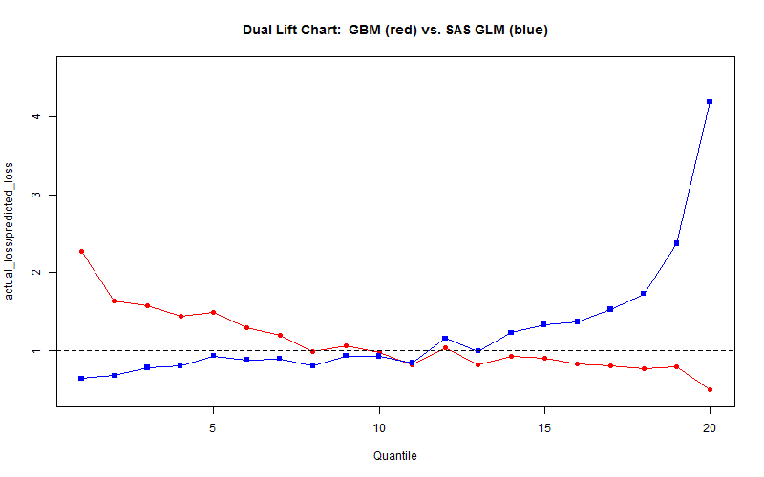
Ensemble Trees by Advanced Analytics Team
GLM vs. Gradient Boosted Tree (GBM)
PIP coverage on 2009-2013 data

Slide 23
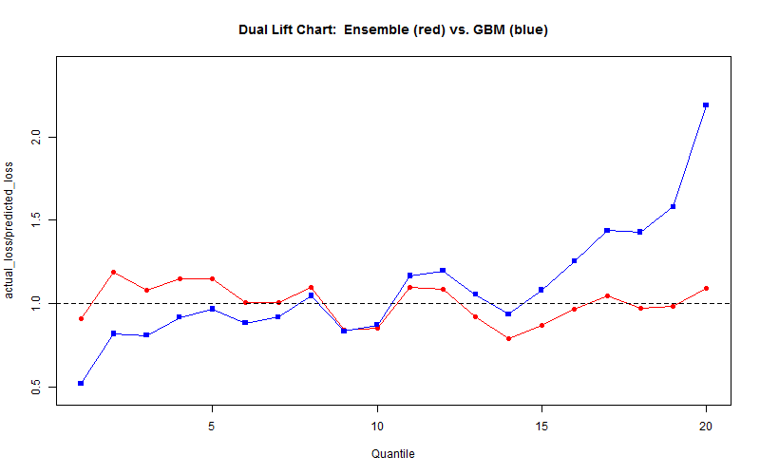
Ensemble Models by Advanced Analytics Team
Gradient Boosted Tree (GBM) vs. GLM+GBM Ensemble Model
PIP coverage on 2009-2013 data

Slide 24
Summary
Machine learning techniques approach modeling from a different perspective and emphasis than traditional statistical modeling techniques (e.g. GLM’s)
More algorithmic perspective than parametric
More focus on prediction and less on interpretation
Ensembling multiple models can often yield better prediction than individual models
Our own experience in claims and loss cost modeling have shown success applying ensemble techniques
Yet traditional statistical modeling are still very useful and applicable in many situations

Slide 25
Questions?

Slide 26
Appendix

Slide 27
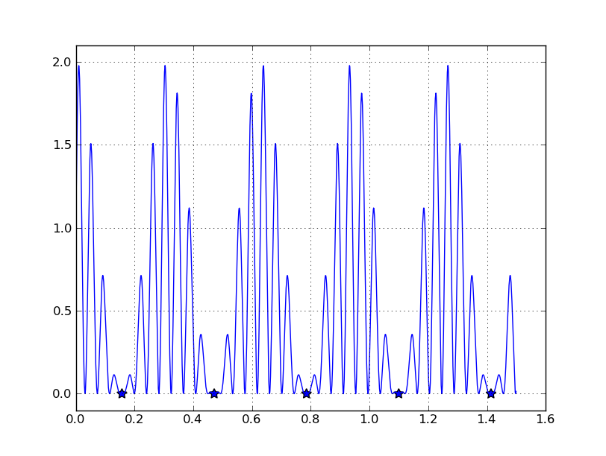
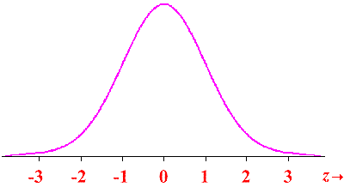
Linear vs. Non-Linear Methods
Linear
Fitting a function - Equation
Long-established theoretical foundation
Methods like least squares and maximum likelihood
Well-known model accuracy metrics: R-square, F-tests
Non-linear
Equations are too complex to be expressed in any form
Calculation intensive – born with advancement in computing
Iterative
Know you are done when the performance of the model stops improving

Slide 28
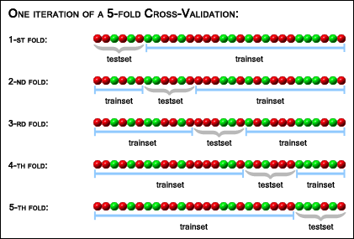
Overfitting
Overfitting:
XXXXX
Cross Validation:
The input Training dataset is partitioned into k subsets of equal size.
Of the k subsets, a single subset is retained as the validation data set, and the remaining k − 1 subsets are used as training data set.
The cross-validation process is then repeated k times, with each of the k subsets used exactly once as the validation data.
This whole process is then repeated for multiple iterations dividing the training dataset in different slices.

Slide 29

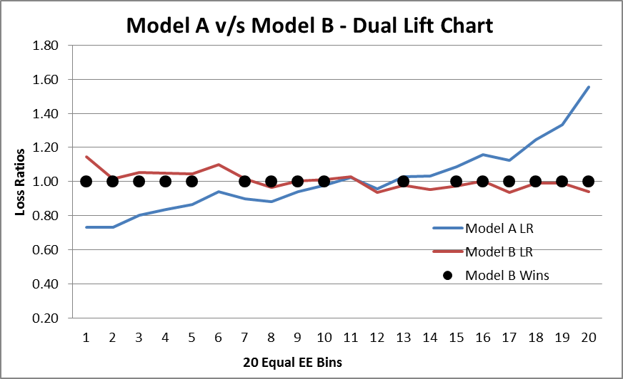
Dual Lift Chart
Dual lift charts compare prediction accuracy between 2 models
Each model produces different (𝑃𝑃) ̂ predictions, sort data by predictions ratio
Create 10 deciles (N bins) of equal exposures and compare loss ratios (actual losses / predicted losses) by decile for each model
Performance is evaluated by distance of loss ratio for each decile for each model from 1.00 relativity.
Smaller distance from 1.0 indicates better fit.

